Slide 1
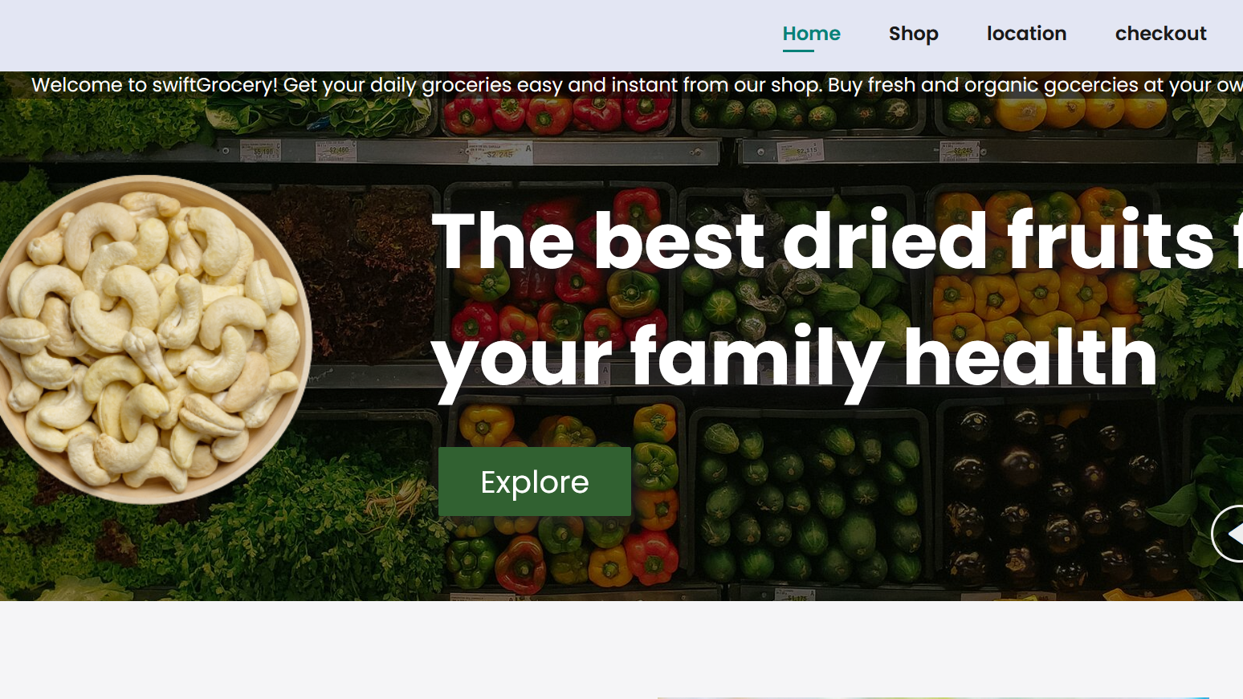


SWIFT GROCERY DELIVERY WEB APP
This is a platform aimed at providing a convenient and efficient way for users to order groceries online and have them delivered to their doorstep.
The main objective of the project is to simplify the grocery shopping experience and save users' time by offering a seamless and user-friendly web application.
Free Shipping
Fresh Vegetables
Good Price

Slide 2

INTRODUCTION TO THE TEAM
Project Manager: Rachel Oyondi
Front-end Developer: Peter Onsomu
Back-end Developer: Rachel Oyondi
UI/UX Designer: Peter Onsomu
Quality Assurance Tester: Rachel Oyondi
Key Milestones or Achievements
Successful completion of the project planning phase.
Development and implementation of the user registration and login system.
Integration of a secure payment gateway for online transactions.
Launch of the live demo version for user testing and feedback.

Slide 3
ARCHITECTURE AND TECHNOLOGIES
The Swift Grocery Delivery Web App follows a client-server architecture. The client-side is built using HTML, CSS, and JavaScript, providing a responsive and interactive user interface. We used the following technologies:
Front-end technologies:
HTML5
CSS3
JavaScript
React.js
Back-end technologies:
Node.js
Express.js
RESTful API
Third Part services:
Payment Gateway Integration
(e.g., M-pesa, PayPal)
Google Maps API
Firebase Authentication
AWS S3
Database:
MySQL
PostgreSQL

Slide 4
DEVELOPMENT REPORT
The development process for the Swift Grocery Delivery Web App involved gathering, design, implementation, testing, and deployment.
Successes achieved during the project:
- Successful implementation of core features such as user registration, product listing, cart management, and order placement.
- Integration of third-party services like payment gateways and Google Maps API for enhanced functionality.
- Responsive and user-friendly design, providing an intuitive user experience.
- Meeting project milestones and deliverables within the set timeline.

Slide 5
DEVELOPMENT REPORT CONT.....
Challenges faced during the project:
- Integration challenges with third-party services: Dedicated time and effort were invested in understanding the documentation and resolving the technical issues.
- Performance optimization: Regular profiling and optimization techniques were applied
- Cross-browser compatibility: Thorough testing and debugging were performed
Areas for improvement identified
- Enhanced error handling and error reporting to provide better user feedback.
- Implementing more advanced search and filtering options for improved product discovery.
- Enhancing the scalability and performance of the database to handle a larger volume of transactions.

Slide 6
CONCLUSION
Developing the Swift Grocery Delivery Web App has been an exciting and rewarding journey. We have successfully created a user-friendly platform that provides convenient grocery shopping and delivery services to our customers. The app has received positive feedback and has gained popularity among users in our target market.

Slide 7
AREAS OF IMPROVEMENT
- We learned the importance of creating a seamless and intuitive interface that makes grocery shopping effortless for our users.
- Collaboration and effective communication within the team were crucial to meet project deadlines and deliver high-quality results.
- Adapting to changes and iterating on the app based on user feedback and market demands helped us improve the app's functionality and user satisfaction.
- Continuous testing and bug fixing throughout the development process ensured a stable and reliable app.

Slide 8
NEXT STEPS
- Expand the app's reach to additional cities and regions, targeting a larger user base.
- Collaborate with local grocery stores to increase product offerings and availability.
- Develop a mobile application version of the web app to cater to users on-the-go.
- Explore partnerships with delivery services to provide faster and more efficient delivery options.
- Conduct user feedback sessions and implement improvements based on user suggestions.

